Slide 1
Azure Service Fabric Overview
Himanshu Desai (Principal Consultant, Readify)

Slide 2
What Is Azure Service Fabric?

Slide 3
Microsoft Azure Service Fabric A platform for reliable, hyperscale, microservice-based applications
Microservices
High Availability
Data Partitioning
Service Fabric
Health Monitoring
Code Orchestration & Lifecycle Management
Hybrid Operations
Self-healing
Simple programming models
High Density
Rolling Upgrades
Low Latency
Placement Constraints
Replication & Failover
Stateful Services
Fast Startup & Shutdown
Resource Management
Hyper-Scale
Automated Rollback
Azure
Private cloud
Other clouds

Slide 4
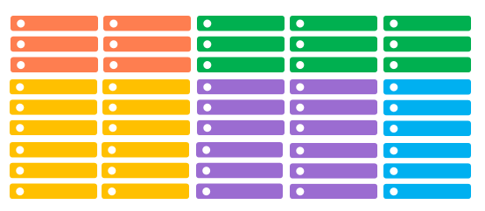
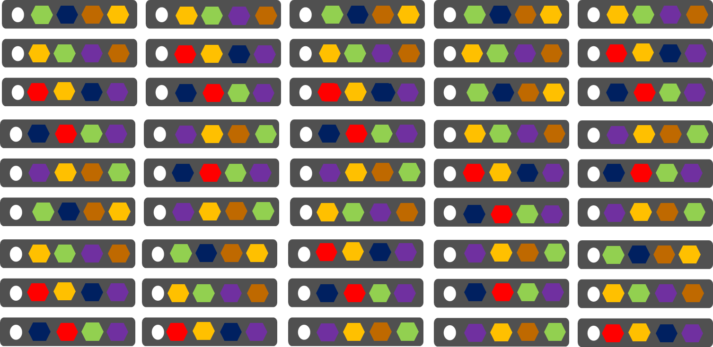
Comparing Azure Cloud Services vs. Azure Service Fabric
Azure Cloud Services
(Web and Worker Roles)
Azure Service Fabric
(Stateless, stateful or Actor services)
1 role instance per VM
Uneven utilization
Low density
Slow deployment & upgrade (bound to VM)
Slow scaling and failure recovery
Limited fault tolerance
Many microservices per VM
Even Utilization (by default, customizable)
High density (customizable)
Fast deployment & upgrade
Fast scaling of independent microservices
Tunable fast fault tolerance

Slide 5
Cluster
Set of OS instances (real or virtual) stitched together to form a pool of resources
Cluster can scale to 1000s of machines, is self repairing, and scales-up or down
Acts as environment-independent abstraction layer
Windows OS
Windows OS
Windows OS
Fabric
Node
Fabric
Node
Fabric
Node
Windows OS
Windows OS
Windows OS
Fabric
Node
Fabric
Node
Fabric
Node

Slide 6
Service type
Services types are composed of code/config/data packages
Code packages define an entry point (dll or exe)
Config packages define service specific config information
Data packages define static resources (eg. images)
Packages can be independently versioned
<ServiceManifest Name="QueueService" Version="1.0">
<ServiceTypes>
<StatefulServiceType ServiceTypeName="QueueServiceType" HasPersistedState="true" />
</ServiceTypes>
<CodePackage Name="Code" Version="1.0">
<EntryPoint>
<ExeHost>
<Program>ServiceHost.exe</Program>
</ExeHost>
</EntryPoint>
</CodePackage>
<ConfigPackage Name="Config" Version="1.0" />
<DataPackage Name="Data" Version="1.0" />
</ServiceManifest>
Service Type 1
Code
Config
Data

Slide 7
Application type
Declarative template for creating an application
Based on a set of service types
Used for packaging, deployment, and versioning
Application Type A
Service Type 1
Service Type 2
Service Type 3
Code
Config
Data
Code
Config
Data
Code
Config
Data

Slide 8
What Is Microservice?

Slide 9
Microservices vs. Monoliths

Slide 10

Monolithic application approach
Microservices application approach
A monolithic application has most of its functionality within a few processes that are componentized with libraries.
Scales by cloning the app on multiple servers/VMs/Containers
App 1
App 1
App 2
A microservice application separates functionality into separate smaller services.
Scales out by deploying each service independently creating instances of these services across servers/VMs/containers

Slide 11


State in Monolithic approach
State in Microservices approach
Single monolithic database
Tiers of specific technologies
Graph of interconnected microservices
State typically scoped to the microservice
Variety of technologies used
Remote Storage for cold data
stateless presentation services
stateless services
stateful services
stateless services with
separate stores

Slide 12
Microservices with Azure Service Fabric

Slide 13
Service Fabric Microservices
App1
App2
App Type Packages
Service Fabric Cluster VMs

Slide 14
Handling Machine Failures
#FAIL
App1
App2
App Type Packages
Service Fabric Cluster VMs

Slide 15
Stateful Microservices - Replication
Primary
Secondary
Replication
Service Fabric Cluster VMs

Slide 16
Service Fabric Programming Models
Guest Executables
Bring any exe
Any language
Any programming model
Packaged as Application
Gets versioning, upgrade, monitoring, health, etc.
Reliable Services
Stateless & stateful services
Concurrent, granular state changes
Use of the Reliable Collections
Transactions across collections
Full platform integration
Reliable Actors
Stateless & stateful actor objects
Simplified programming model
Single Threaded model
Great for scaled out compute and state

Slide 17
Programming models: Reliable Services
Reliable collections make it easy to build stateful services
An evolution of .NET collections - for the cloud
ReliableDictionary<T1,T2> and ReliableQueue<T>
Collections
Single machine
Single-threaded
Concurrent Collections
Single machine
Multi-threaded
Reliable Collections
Multi-machine
Replicated (HA)
Persistence (durable)
Asynchronous
Transactional

Slide 18
Transactionally Modifying Reliable Data
protected override async Task RunAsync(CancellationToken cancellationToke)
{
var requestQueue = await this.StateManager.GetOrAddAsync<IReliableQueue<CustomerRecord>>(“requests");
var locationDictionary = await this.StateManager.GetOrAddAsync<IReliableDictionary<Guid, LocationInfo>>(“locs");
var personDictionary = await this.StateManager.GetOrAddAsync<IReliableDictionary<Guid, Person>>(“ppl");
var customerListDictionary = await this.StateManager.GetOrAddAsync<IReliableDictionary<Guid, object>>(“customers");
while (true)
{
cancellationToke.ThrowIfCancellationRequested();
Guid customerId = Guid.NewGuid();
using (var tx = this.StateManager.CreateTransaction())
{
var customerRequestResult = await requestQueue.TryDequeueAsync(tx);
await customerListDictionary.AddAsync(tx, customerId, new object());
await personDictionary.AddAsync(tx, customerId, customerRequestResult.Value.person);
await locationDictionary.AddAsync(tx, customerId, customerRequestResult.Value.locInfo);
await tx.CommitAsync();
}
}
}
Everything happens or nothing happens!

Slide 19
Programming models: Reliable Actors
Independent units of compute and state
Large number of them executing in parallel
Communicates using asynchronous messaging
Single threaded execution
Automatically created and dehydrated as necessary

Slide 20
Demo: Service Fabric

